Slide 1


Charles Fanning
2 / 14/ 2024

Slide 2
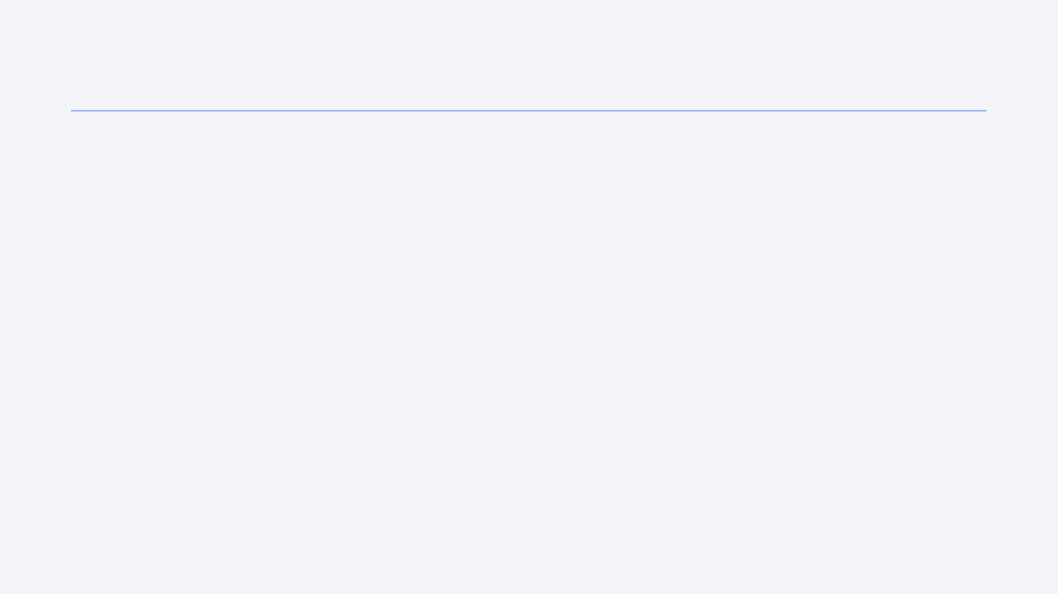
Outline
Executive Summary
Introduction
Methodology
Results
Conclusion
Appendix

Slide 3
Executive Summary
Summary of methodologies
We start with web scraping off the SpaceX API
Then, we used EDA and data preprocessing
We finished with using machine learning to model for extracting insights from the data
Summary of all results
The exploratory data analysis steps made it clear which features were the most relevant from each other
The modeling stage made it clear how each feature implied whether the target variable would be successful.

Slide 4
Introduction
Project background and context
The background is that we want to see if SpaceY is able to compete with SpaceX.
Problems you want to find answers
We want to use regression to estimate what a launch will cost given all the features pertaining to the launch, and we also want to predict where the best places to make launches will be.

Slide 5

Section 1

Slide 6
Methodology
Executive Summary
Data collection methodology:
Half of the data came from webscraping SpaceX’s Wikipedia page and the other half came from the SpaceX API.
Perform data wrangling
Data wrangling involved preprocessing missing values and creating a new feature for the landing outcome that was easier to interpret for a model.
Perform exploratory data analysis (EDA) using visualization and SQL
Perform interactive visual analytics using Folium and Plotly Dash
Perform predictive analysis using classification models
We ran the data through multiple classification models and adjusted the parameters until we got the most accurate possible predictive model

Slide 7
Data Collection
We got our data from the SpaceX heavy launches wikiepdia page and the SpaceX API:
https://en.wikipedia.org/wiki/List_of_Falcon/_9/_and_Falcon_Heavy_launches
https://api.spacexdata.com/v4/rockets/

Slide 8
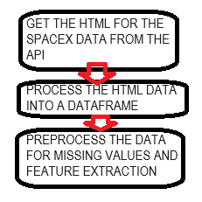
Data Collection – SpaceX API
SpaceX API makes the records of their launches publicly available, so you can pull it up directly from Python.
https://github.com/charlestfanning/captsone/blob/main/Data%20Collection%20API.ipynb
Place your flowchart of SpaceX API calls here

Slide 9
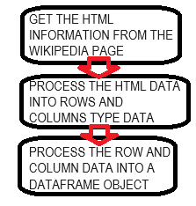
Data Collection - Scraping
We just request the information directly from the Wikipedia page and format the HTML info into a dataframe
https://github.com/charlestfanning/captsone/blob/main/Data%20Collection%20with%20Web%20Scraping.ipynb
Place your flowchart of web scraping here

Slide 10
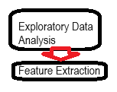
Data Wrangling
EDA was used to investigate the dataset, then the launch outcome column was added
captsone/Data Wrangling.ipynb at main · charlestfanning/captsone (github.com)

Slide 11
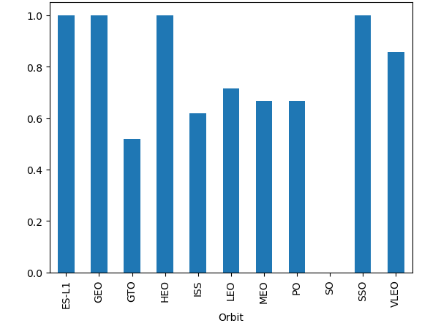
EDA with Data Visualization
The plots included: payload plotted against orbit, orbit plotted against flight number, launch site plotted against payload mass, and payload mass plotted against flight number.
captsone/EDA with Data Visualization.ipynb at main · charlestfanning/captsone (github.com)

Slide 12
EDA with SQL
Got the unique launch sites
Got 5 launch sites beginning with CCA
Got total payload mass
Got average payload mass of F9 1.1
Got date of first successful launch from ground pad
Got the names of successful boosters with weight between 4 and 6 thousand
Got total number of successes and failures for missions
Got rank and count of landing outcomes
captsone/EDA.ipynb at main · charlestfanning/captsone (github.com)

Slide 13
Build an Interactive Map with Folium
Used markers to indicate specific points
Used circles to indicate specific areas
Used markers to indicate events at a point
Used lines to indicate distances between points
captsone/Interactive Visual Analytics with Folium lab.ipynb at main · charlestfanning/captsone (github.com)

Slide 14
Build a Dashboard with Plotly Dash
The plots that were used for the dashboard were the percentage of launches by site and the payload range and it allows to see the relationship between payload range and launches by site.

Slide 15
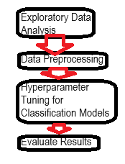
Predictive Analysis (Classification)
The models for classification were logistic regression, SVM, decision trees, and KNN
captsone/Machine Learning Prediction.ipynb at main · charlestfanning/captsone (github.com)

Slide 16
Results
SpaceX has four launch sites, and the average payload of F9 1.1 booster is 2928 kilograms. The first successful landing was in 2017.
There were two booster versions that has failures in 2015, B1012 and B1015.
The landing outcomes tended more towards success over time.

Slide 17

Section 2

Slide 18
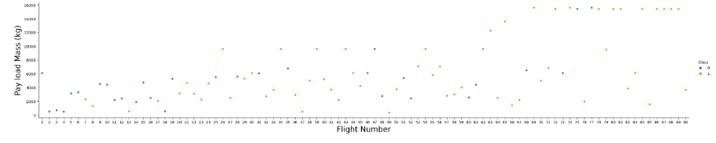
Flight Number vs. Launch Site
For 1 there was a clear positive correlation between flight number and payload mass, but for 0 the correlation is less clear

Slide 19
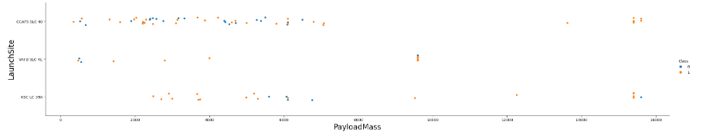
Payload vs. Launch Site
1 tends to have a higher payload mass than 0, and those larger payload masses tend to be associated with launch sites that do not have many observations for 0

Slide 20
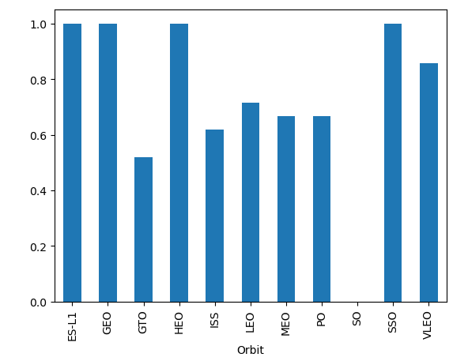
Success Rate vs. Orbit Type
Most of them are fine, SO is the least successful orbit type, and ES-L1, GEO, HEO, and SSO are the most succesful

Slide 21
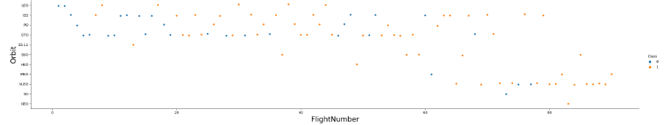
Flight Number vs. Orbit Type
For both types of observation, there is surprisingly a negative correlation between flight number and orbit

Slide 22
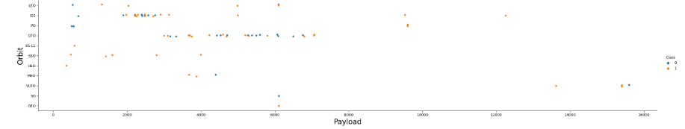
Payload vs. Orbit Type
Most smaller payload masses are correlated with the same few orbit types, but the larger payloads are scarce and concentrated at the lower orbits too.

Slide 23
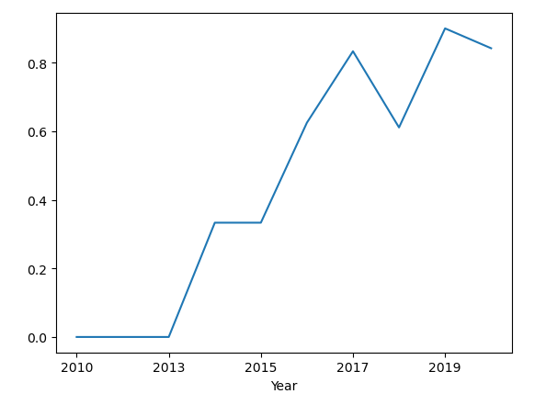
Launch Success Yearly Trend
There is a positive trend between launch success and year

Slide 24
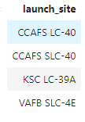
All Launch Site Names
The different launch site names are CCAFS LC-40, CCAFS SLC-40, KSC LC-39A, and VAFB SLC-4E

Slide 25
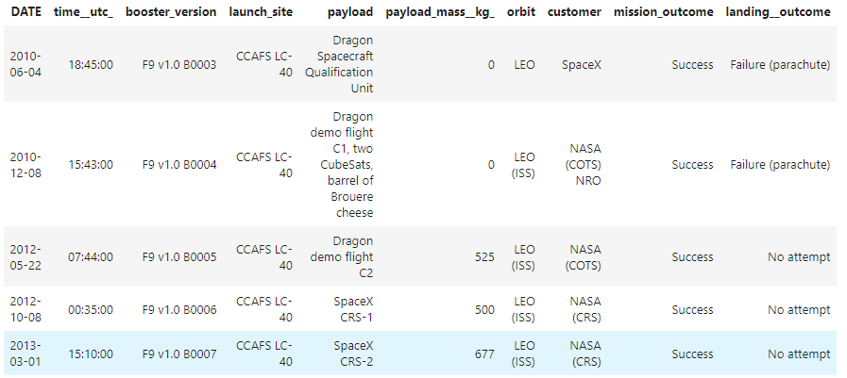
Launch Site Names Begin with 'CCA'
These are the launch sites beginning with CCA along with their DATe, time, booster version, payload, payload mass, orbit, customer, mission outcome, and landing outcome

Slide 26
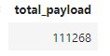
Total Payload Mass
The total payload mass is 111268

Slide 27
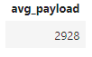
Average Payload Mass by F9 v1.1
The average payload mass by F9 v1.1 is 2928 kg

Slide 28
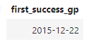
First Successful Ground Landing Date
First success was on 2015-12-22

Slide 29
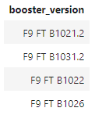
Successful Drone Ship Landing with Payload between 4000 and 6000
The different successful drone ship landings with payload between 4000 and 6000 are F9 FT B1021.2, F9 FT B1031.2, F9 FT B1022, and F9 FT B1026

Slide 30
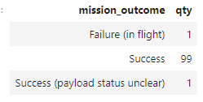
Total Number of Successful and Failure Mission Outcomes
The different mission outcomes are failure, success, and success (payload status unclear), all 1 except success with is 99

Slide 31
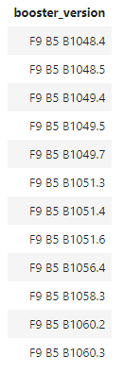
Boosters Carried Maximum Payload
The boosters that have carried the maximum payload are as given in the table to the left

Slide 32
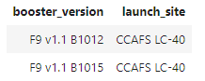
2015 Launch Records
The 2015 booster versions are F9 v1.1 B1012 and F9v1.1 B1015 both launched from CCAFS LC-40

Slide 33
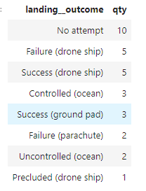
Rank Landing Outcomes Between 2010-06-04 and 2017-03-20
The landing outcomes from between 2010 and 2017 are more varied than the other landing outcomes given previously, these mostly being no attempt and having more failures

Slide 34

Section 3

Slide 35
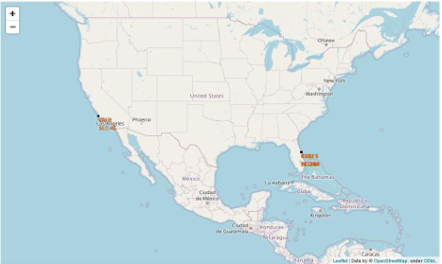
<Folium Map Screenshot 1>
The sides are very spread out across the country and tend to be very near to the coast.

Slide 36

<Folium Map Screenshot 2>
more launch sites screenshots

Slide 37

<Folium Map Screenshot 3>
More launch sites screenshots

Slide 38

Section 4

Slide 39
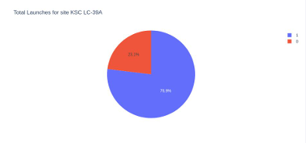
<Dashboard Screenshot 1>
For the KSC LC-39A there were 25% launches with value 0 and 75% with value 1

Slide 40

Section 5

Slide 41
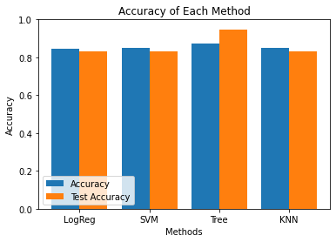
Classification Accuracy
All of the models have around 80% for training and test accuracy but training accuracy is higher for most of them so probably mostly overfit except for tree where test accuracy is even higher than train accuracy, so it honestly probably just got lucky but still looks most promising anyways

Slide 42
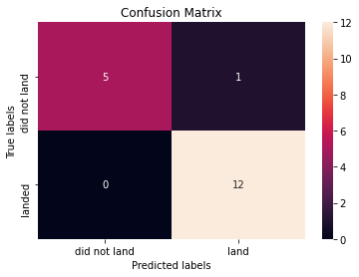
Confusion Matrix
Mostly true positive and true negative, it was only wrong when it predicted lan when it truly did not land once, so overall pretty good.

Slide 43


